Slide 1
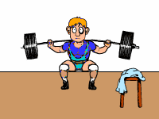
Work, Energy & Power
Physics

Slide 2
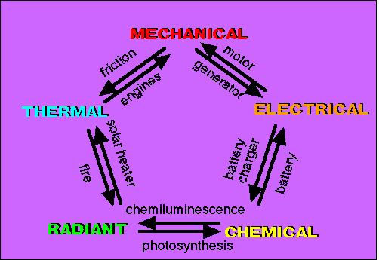
There are many different TYPES of Energy.
Energy is expressed in JOULES (J)
4.19 J = 1 calorie
Energy can be expressed more specifically by using the term WORK(W)
Work = The Scalar Dot Product between Force and Displacement. So that means if you apply a force on an object and it covers a displacement you have supplied ENERGY or done WORK on that object.

Slide 3
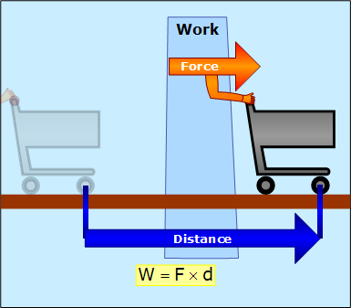
Scalar Dot Product?
A product is obviously a result of multiplying 2 numbers. A scalar is a quantity with NO DIRECTION. So basically Work is found by multiplying the Force times the displacement and result is ENERGY, which has no direction associated with it.
A dot product is basically a CONSTRAINT on the formula. In this case it means that F and d MUST be parallel. To ensure that they are parallel we add the cosine on the end.
FORCE
Displacement

Slide 4
Atlas holds up the Earth
But he doesn’t move, d = 0
Work= F·d = 0
He doesn’t do any work!

Slide 5
Garcon does work when he picks up the tray
but not while he
carries it around
the room
dist is not zero,
but dist∥ is 0

Slide 6
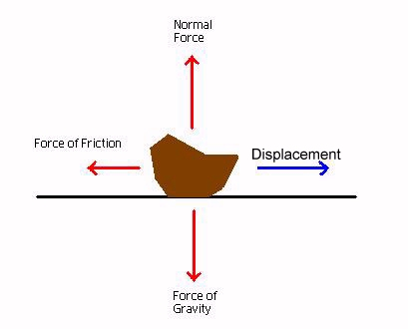
Work
FORCE
Displacement

Slide 7
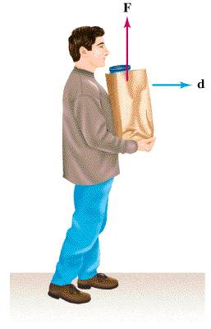
Work
FORCE
Displacement

Slide 8
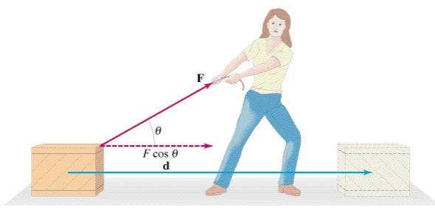
Work
In the figure above, we see the woman applying a force at an angle theta. Only the HORIZONTAL COMPONENT actually causes the box to move and thus imparts energy to the box. The vertical component (FsinΘ) does NO work on the box because it is NOT parallel to the displacement.

Slide 9
What is energy?
“the ability to do work”
The combination of energy and matter makes up the universe:
Matter is substance, and energy is the mover of substance.

Slide 10
How is all energy divided?
All Energy
Potential
Energy
Kinetic
Energy
Gravitation
Potential
Energy
Elastic
Potential
Energy
Chemical
Potential
Energy

Slide 11
Potential Kinetic
energy of position or energy in storage.
Water behind a dam
Hammer over head
Food on the plate
energy of motion, the form capable of doing work
Flowing water
A falling hammer
Electrons regenerating ATP in a bio’l cell

Slide 12
KE = 1/2 m v²
4 kg bowling ball
at 10 m/s
= .5 (4kg) (10m/s)²
= 200 J
.25 kg baseball
at 50 m/s
= .5 (.25kg) (50 m/s)²
= 312 J

Slide 13
Doing Work Gives Energy to Objects
When work is done on an object:
Energy is transferred from the object doing the work to the object having work done on it
The object doing the work loses energy
The object having work done on it gains energy
EX. A student pushing a desk across the floor is doing work on the desk – energy is transferred from the student to the desk and the student loses energy

Slide 14
Why do we get tired after doing work?
We give up our energy to all the objects we touch and move around
In any energy transfer in our body, some energy is changed to heat and transferred to our environment – the energy is LOST from our body
Staying alive requires a lot of energy
Heart beating, brain sending messages, cells moving substances in and out, muscle contractions, etc.
As our body’s energy gets low, we get tired

Slide 15
Work-Energy Theorem
The result of work is that there is a change of speed, or an acceleration.
W=F•d
W=ma•d
v_{f}² = v_{i}² + 2ad and solve for ‘ad’
ad = (v_{f}² – v_{i}²)/2
W=m(v_{f}² – v_{i}²)/2
W=mv_{f}² – mv_{i}²
2

Slide 16
Work-Energy Theorem

Slide 17
Work-Energy Theorem

Slide 18
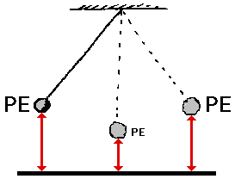
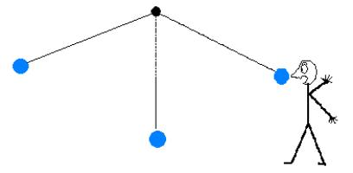
POTENTIAL ENERGY (PE)
-The energy of REST
-Objects at REST have POTENTIAL ENERGY
-Potential Energy is CHANGED into KINETIC ENERGY when MOTION occurs

Slide 19
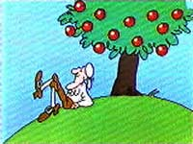
TYPES OF POTENTIAL ENERGY
5. Gravitational Potential Energy: Energy stored by objects due to their POSTION ABOVE EARTH
-Ex: Anything with the potential to FALL
-Depends on: MASS and HEIGHT above ground
-Equation:
GPE (J) = Mass (kg) X gravity (m/s²) X height (m)
GPE = mgh

Slide 20
GPE Example Problem
-What is the GPE of a ceiling fan that has a mass of 7kg and is 4m above the ground?
GPE = mgh
Gravity = 9.8 m/s²
Mass = 7 kg
Height = 4 m
GPE = (7kg)(9.8m/s²)(4m)
= 274 kgm²/s² = 274 J

Slide 21
Spring Potential Energy
Springs possess potential energy if they are elongated or compressed from their rest positions.
This is called spring (or elastic) potential energy.
The formula is derived from Hooke’s Law:

Slide 22
Spring Potential Energy

Slide 23
Conservation of Energy
Energy is conserved in all systems. This means that in the Universe, all the energy that was at the beginning of time is still in the Universe today.
As we isolate systems, we find that the total energy before is equal to the total energy after.
The energy just changes form.

Slide 24
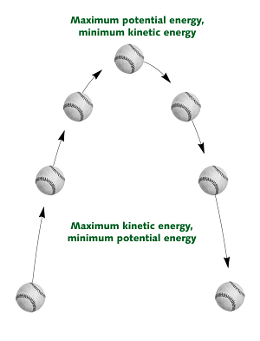
The Change of GPE to KE
-As objects fall, GPE is changed into KE
-KE is LARGEST right before the object hits the ground, thus GPE is the SMALLEST right before hitting the ground
-Objects with MORE GPE move FASTER because they have more KE

Slide 25
Mechanical Energy
ME = KE + PE
ME_{i} = ME_{f}

Slide 26
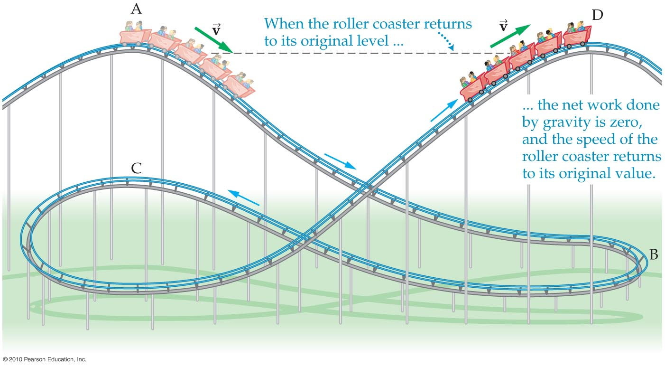
The Roller Coaster

Slide 27
Energy consistently changes forms

Slide 28
Roller coaster

Slide 29
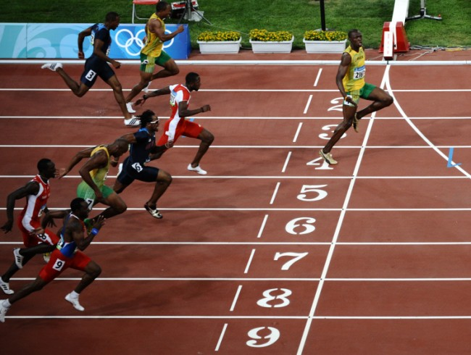
What is power?
Power – the rate at which work is done
More power means…
More work is done in the same amount of time
The same amount of work is done in less time
EX. A person that is a more powerful runner is faster and can run farther in the same amount of time as a less powerful runner (more work in equal time)

Slide 30
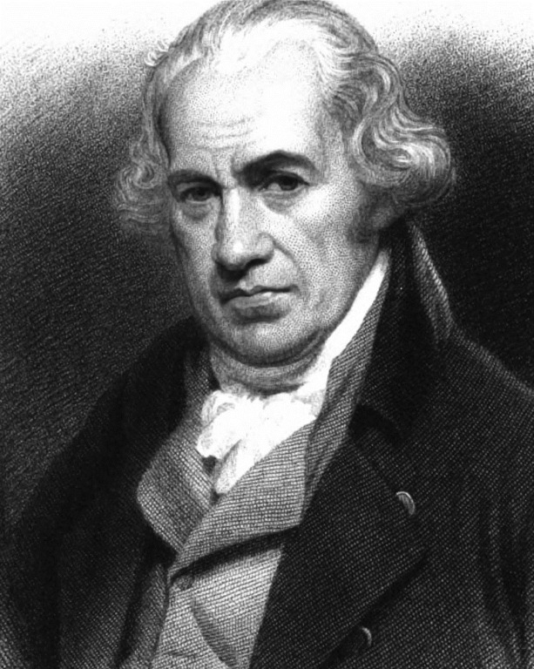
Calculating Power
Power is measured in Watts (W)
We need to know 2 things in order to measure power:
The amount of work being done
The amount of time it takes to do the work
We can calculate power using the following formula:
Power = Work / Time (P = W / t)
1 Watt equals 1 joule divided by 1 second

Slide 31
A Watt Measures Work Done and Energy Used In an Amount of Time
A Watt equals 1 Joule per second
The more watts, the more work is done each second
Joules also measure energy, so a watt also measures energy use per second
EX. A 100W light bulb uses 100J of energy each second that it is on

Slide 32
Calculating Power
Because work equals force multiplied by distance, another way to write the power formula is:
Power = (Force x Distance) / Time
P = (F x d) / t
P = W / t is the same as P = (F x d) / t

Slide 33
POWER !
Power is the rate of doing work.
Power is measured in units called Watts

